Slide 1


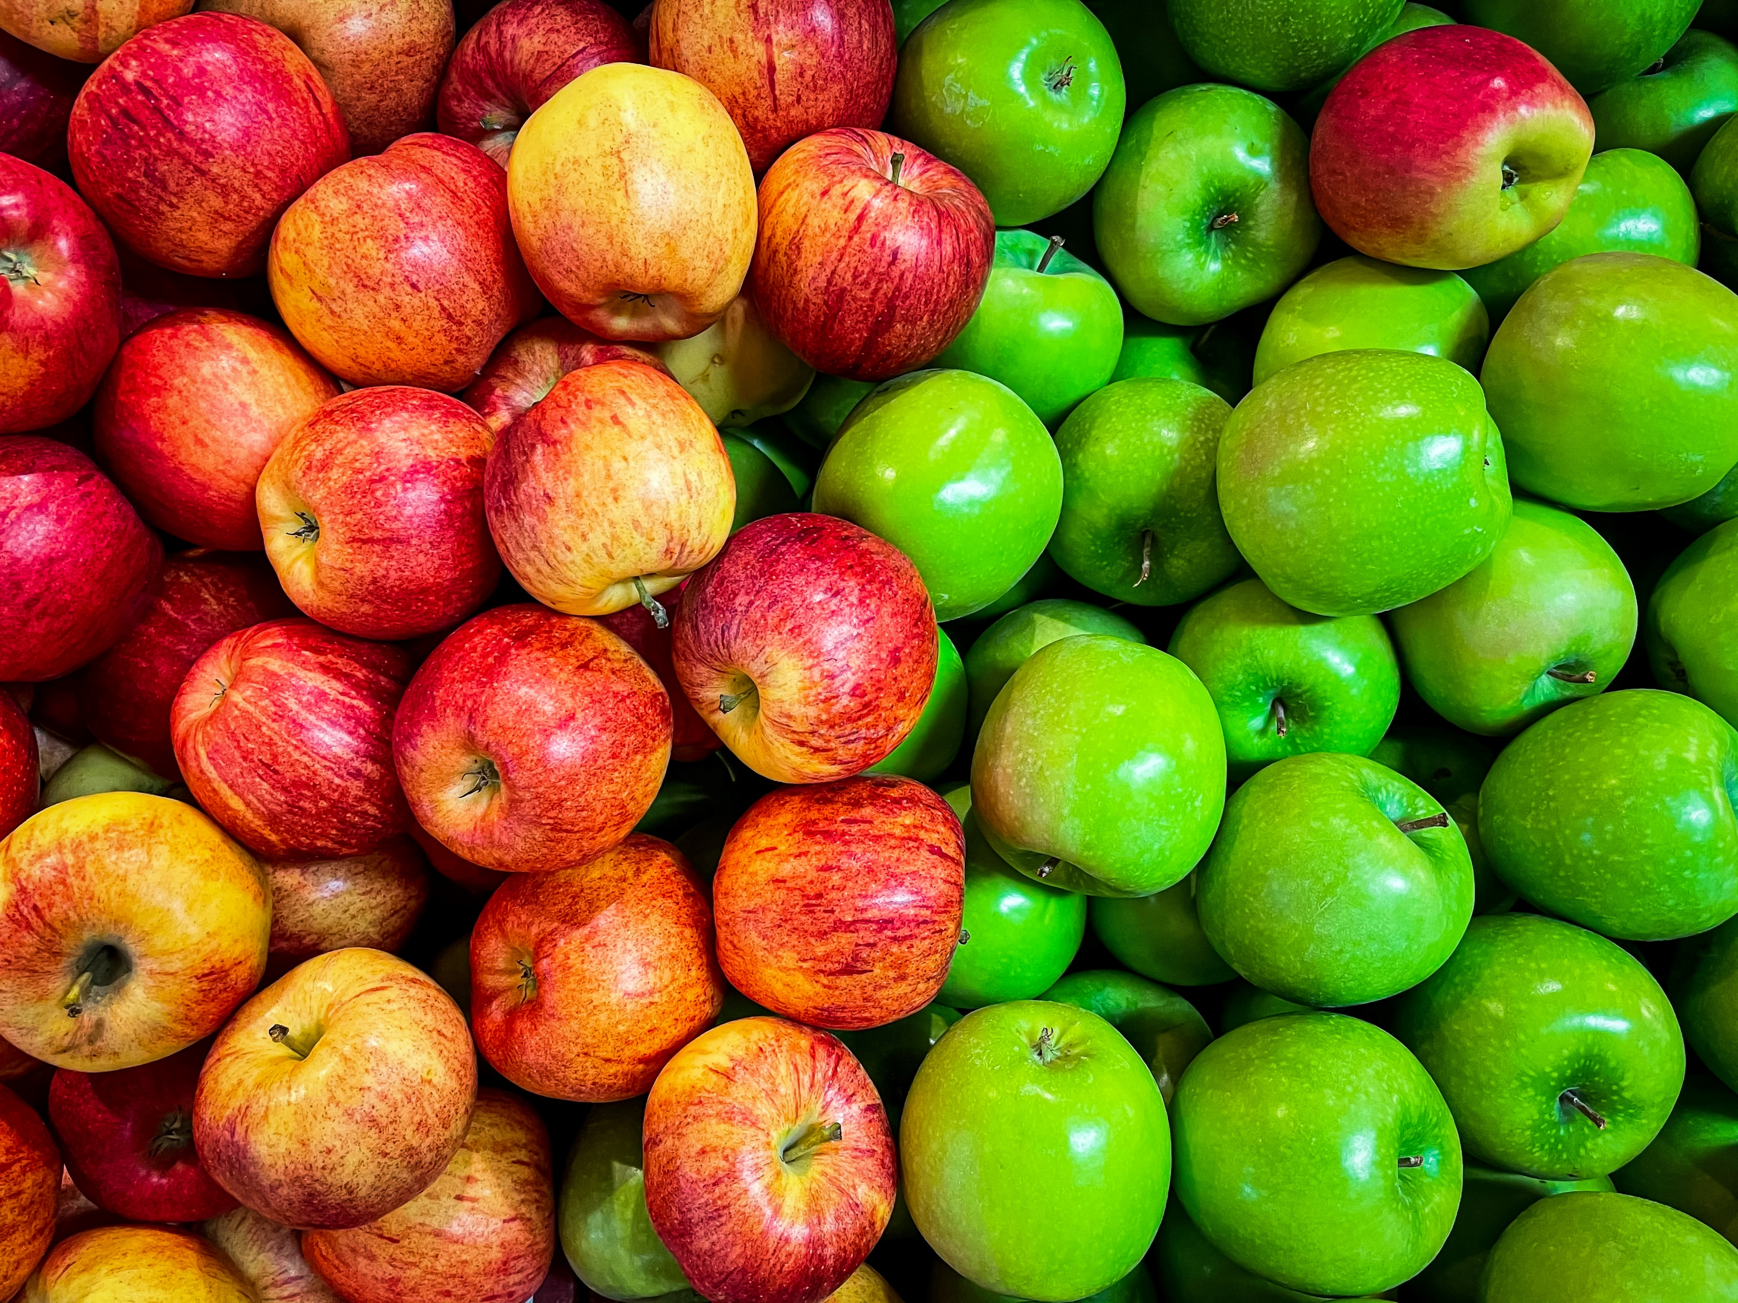
Min 60-75: Break

Slide 2


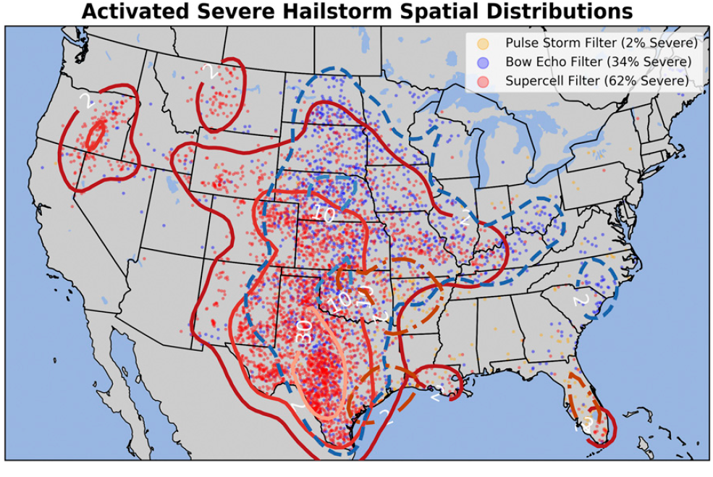
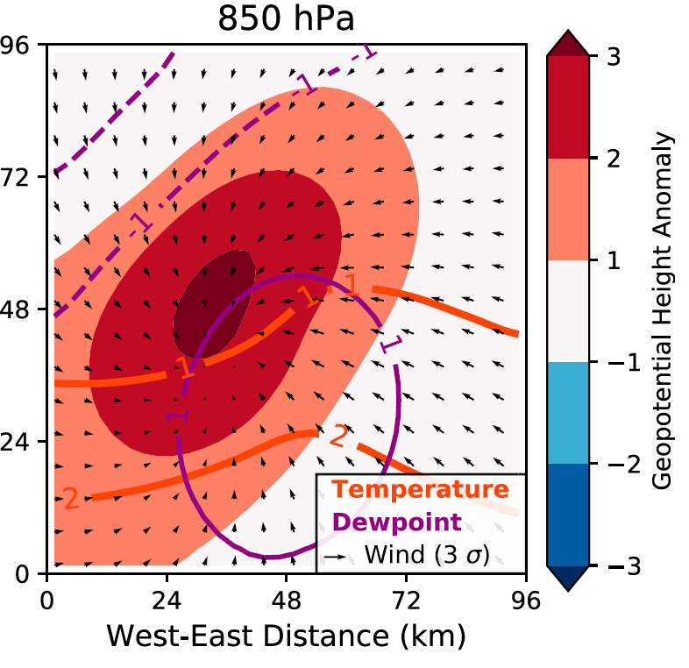
ML for Earth & Env Sci (Week 7, SP2022)
How can we better understand and communicate our ML predictions?
(Left) Which neurons activate? (Right) Which patterns maximize the probability of severe hail?
Source: Gagne et al. (2019)
Notes:
COSERO hydrological model

Slide 3

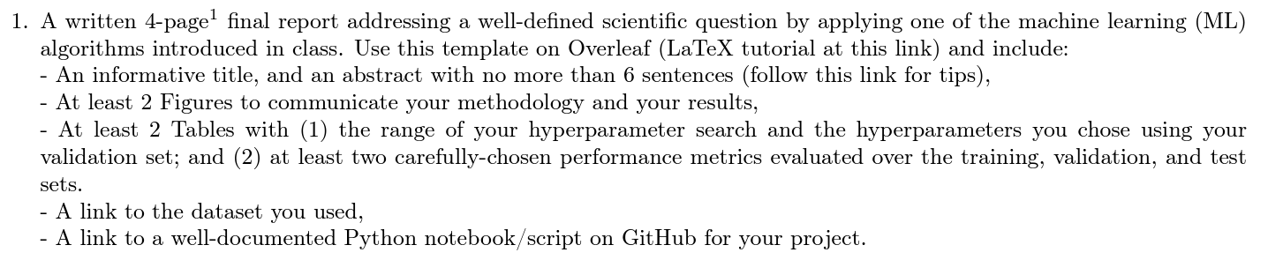
In-class Peer Review: Friday, Dec 8th, 2PM-4PM
Please use the same GitHub username as you used to fork the course’s repository
Submit first draft of your project by Thursday, Dec 7th

Slide 4
Final Presentations in room 2138 Friday, Dec 15th from 2PM to 4PM
Please register
4min presentations + 1min Q&A
Tip = 1 slide/minute
Scientific question: What’s our goal and why do we care?
Dataset: Characteristics, challenges, training/validation/test split, etc.
Methodology: Which ML algorithm(s) did you choose and why?
Results: What are your findings and how does it answer the sci. question?

Slide 5
Min 80-105: Intro to XAI = eXplainable Artificial Intelligence
Learning Objectives (Molnar extracts):
Understand the importance of XAI
Distinguish local from global explanation methods
Distinguish model-agnostic from model-specific methods
Know how to implement permutation feature importance and partial dependence plots
Apprehend explanation methods for neural networks

Slide 6
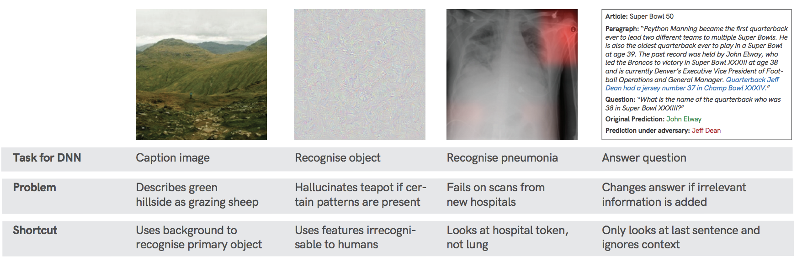
Why bother with XAI?
Environmental examples from students
Horse/label
Would you trust the model
Source: Geirhos et al. (2020) arXiv:2004.07780.
Notes:
VOTE 1: What do you think the bias is?

Slide 7
Why bother with XAI? Because NNs take shortcuts!
Environmental examples from students
Horse/label
Would you trust the model
Source: Geirhos et al. (2020) arXiv:2004.07780.

Slide 8
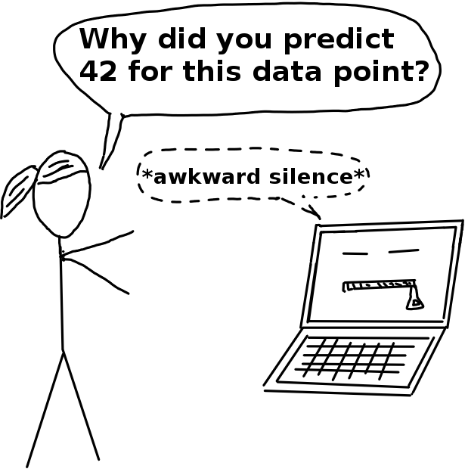
Interpretability = Degree to which a human can understand the cause of a decision
Advantages of XAI: Robustness, Trustworthiness, Scientific Insight
Wildfire susceptibility mapping to inform risk management
Land use classification to inform policy
Spam email detection
When the model output has no importance
Source: Interpretable Machine Learning, C. Molnar (2019)
Notes:
VOTE 2: In which cases do we need XAI?

Slide 9
Interpretability = Degree to which a human can understand the cause of a decision
Advantages of XAI: Robustness, Trustworthiness, Scientific Insight
Wildfire susceptibility mapping to inform risk management
Land use classification to inform policy
Spam email detection
When the model output has no importance
Source: Interpretable Machine Learning, C. Molnar (2019)

Slide 10
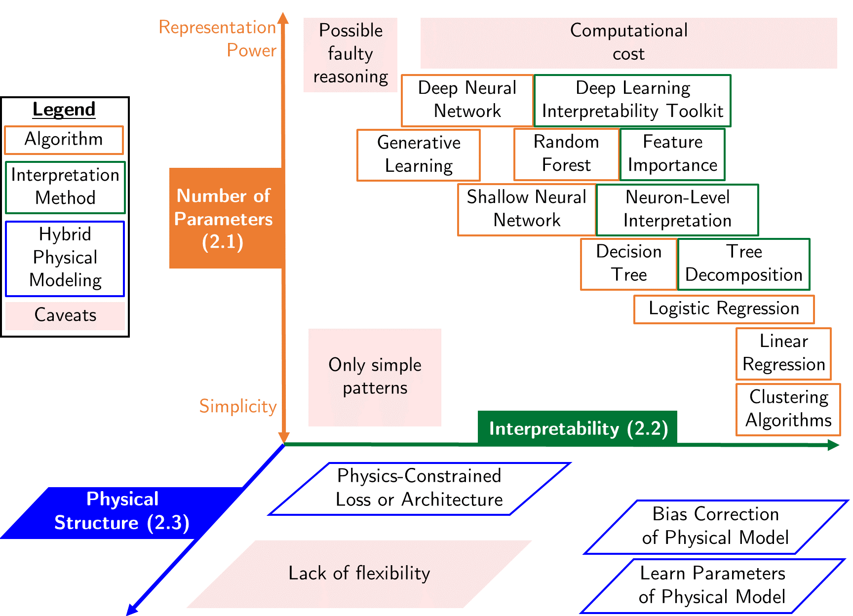
Some algorithms are inherently interpretable
Example: Linear regression with one output and two inputs
Naive: Read coefficients
Feature importance:
(One sample) Compare terms
(Entire set) Average absolute terms over the entire set
Source: Beucler et al. (2021)
Notes:
VOTE 3: Does reading the coefficient always work? In which cases does it not work? How can we solve this?

Slide 11
Local (sample-level) ≠ Global Explanation
Ensemble mean of absolute values
Feature importance:
(One sample) Compare terms
(Entire set) Average absolute terms over the entire set
Source: Beucler et al. (2021)

Slide 12
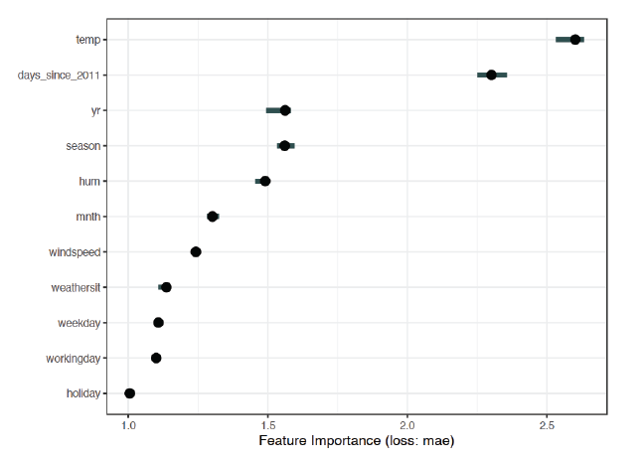
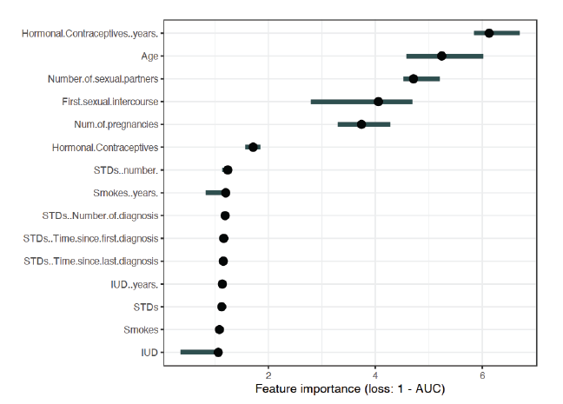
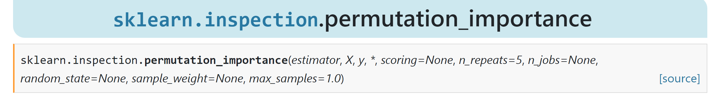
Permutation feature importance = Increase in prediction error in response to feature permutation
temp
Predicting bike counts with SVM
⚠️holiday
For your project: Calculate random PFI on test data using e.g., scikit-learn
Notes:
Example of Global explanation

Slide 13
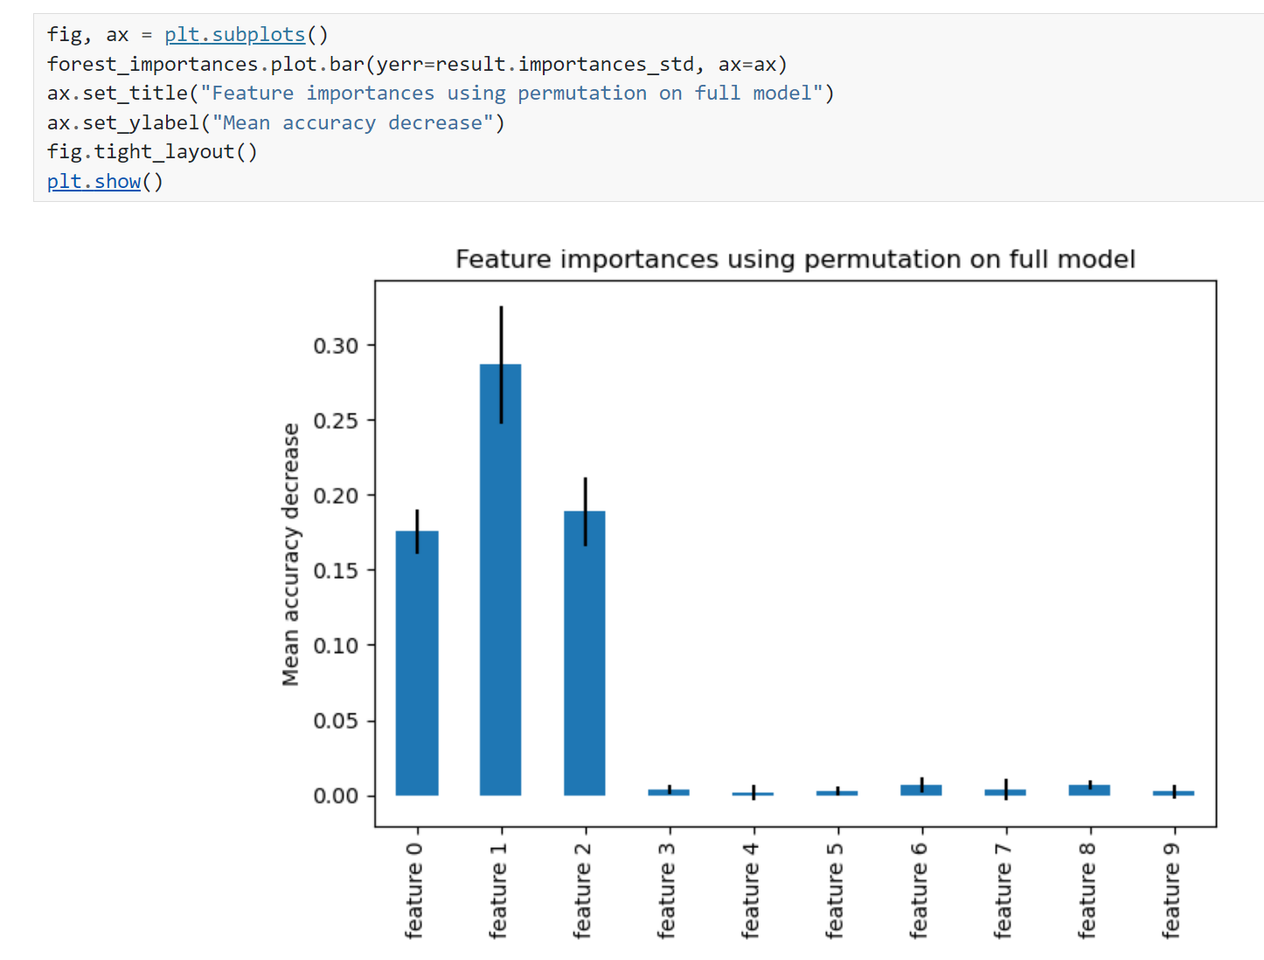
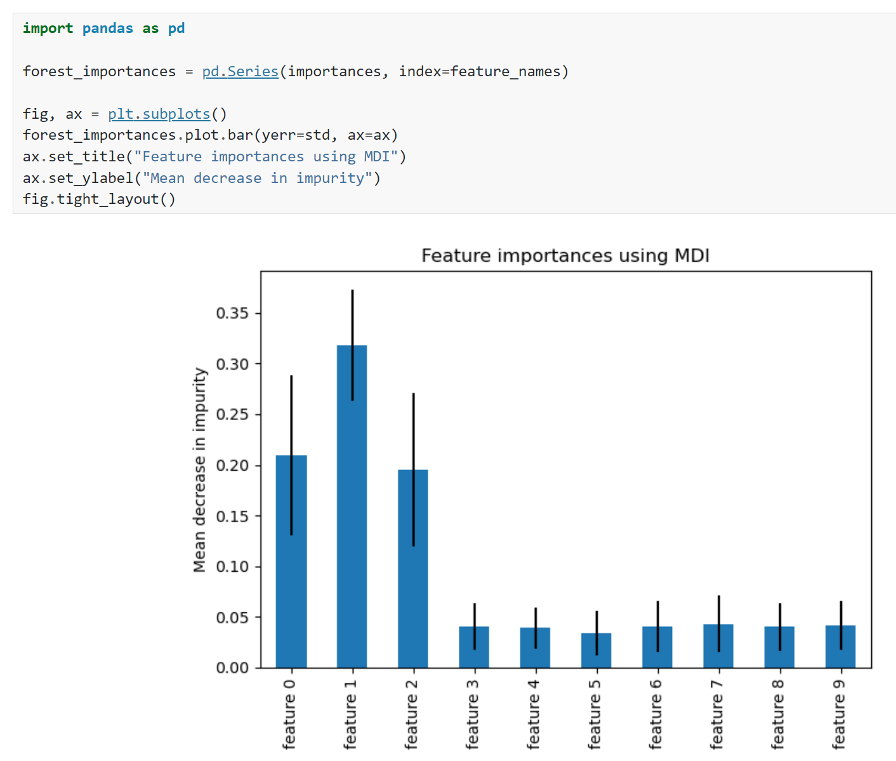
Model-agnostic versus model-specific explanation Example: Random forests (see final project)
Random
Feature
Permutation
Mean Decrease Impurity
Source: https://scikit-learn.org/stable/auto_examples/ensemble/plot_forest_importances.html
Notes:
Vote ☺

Slide 14
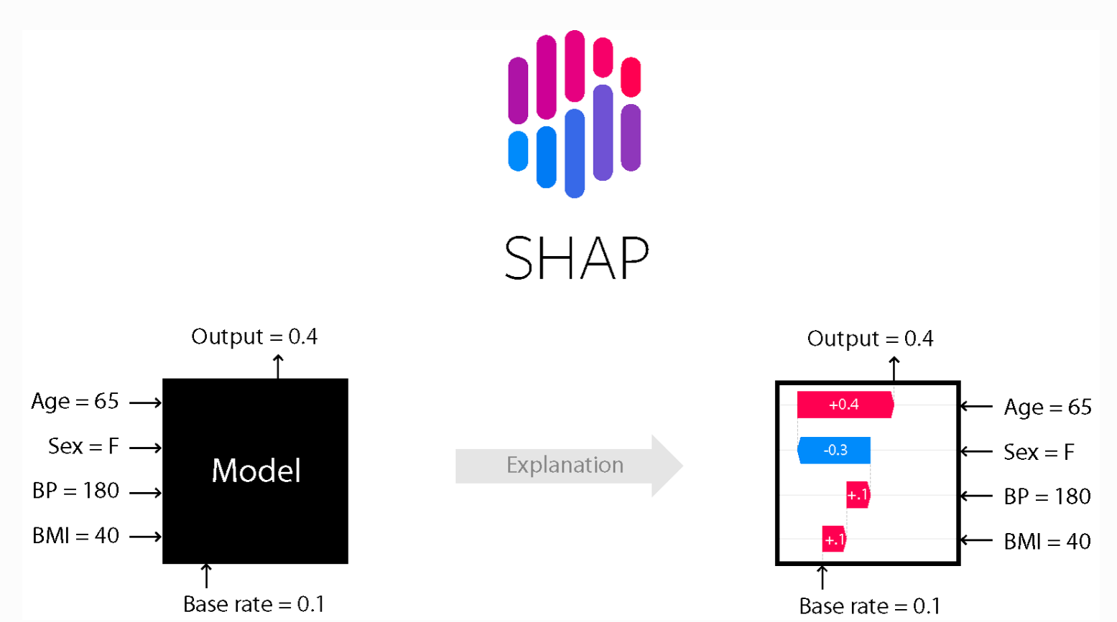
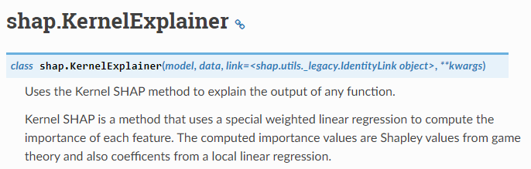
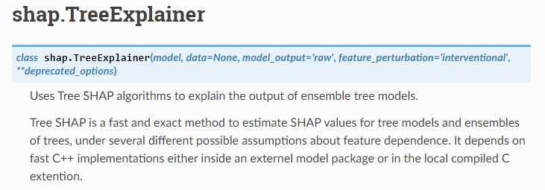
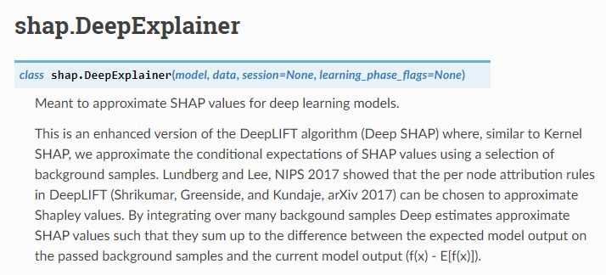
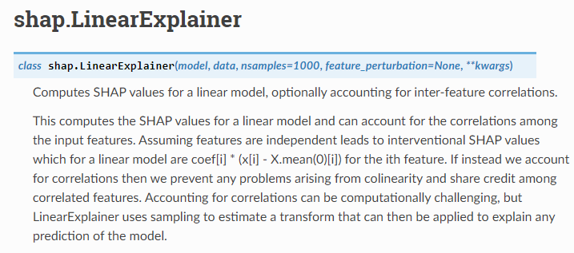
Model-agnostic versus model-specific explanation Example 2: SHAPley values
Source: Shapley (1951), https://shap.readthedocs.io/en/latest/

Slide 15
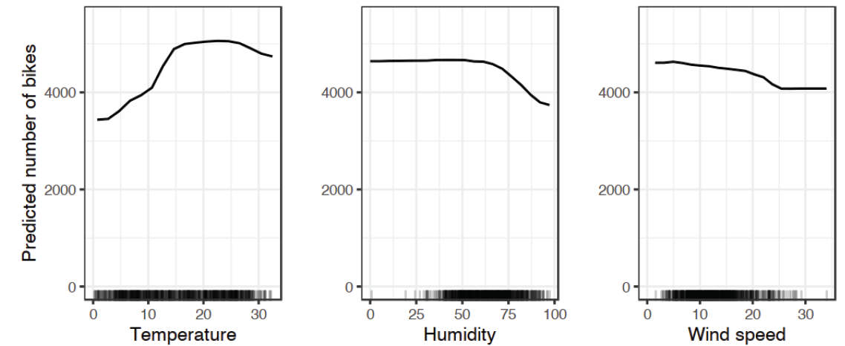


Partial Dependence Plots “show the marginal effect of 1 or 2 inputs on the predicted outputs”

Slide 16

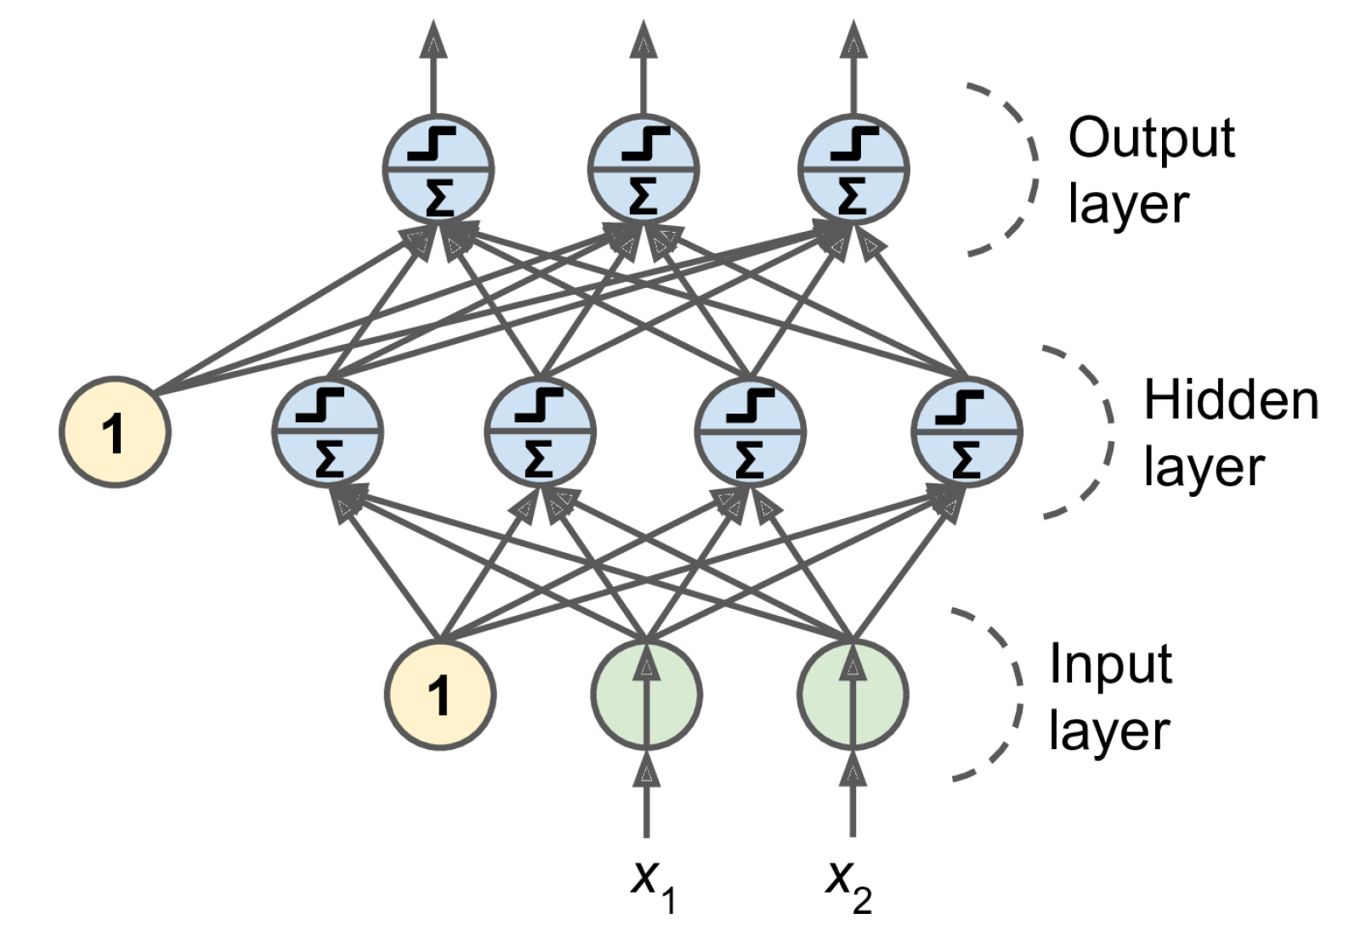
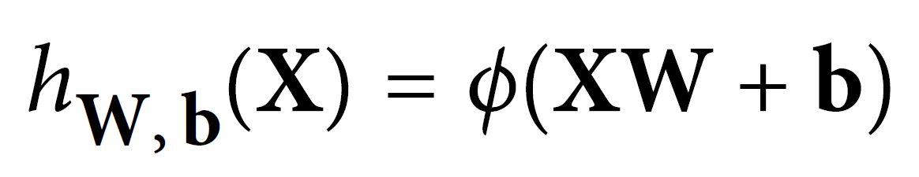
3 weeks ago = general case: Artificial Neural Networks
Notes:
1 layer = similar to logistic regression
2 layers = shallow neural network
Deep learning = 3 layers and above

Slide 17


2 weeks ago = Convolutional Neural Networks (CNNs)
Regularized versions of Artificial Neural Networks used to process images
Source: Giphy, Analytics India Magazine (K. Maladkar)

Slide 18
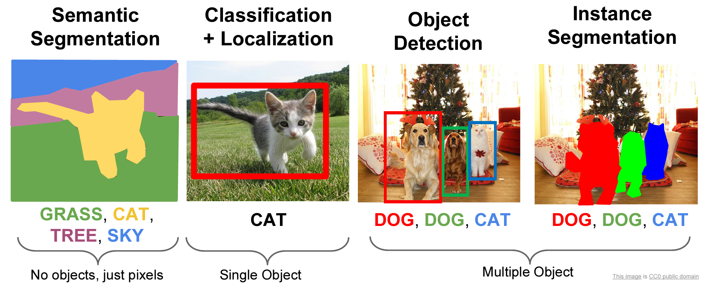
CNNs used for computer vision (analyzing images, videos)
Source: Stanford (CS231)

Slide 19
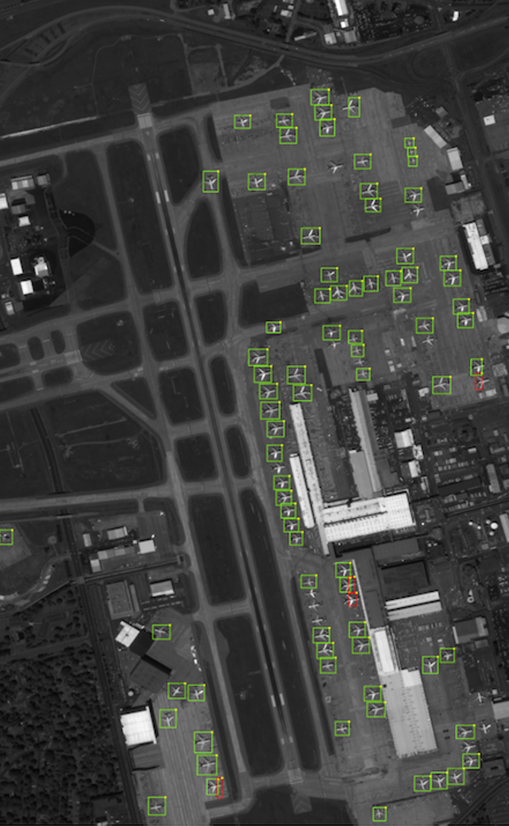
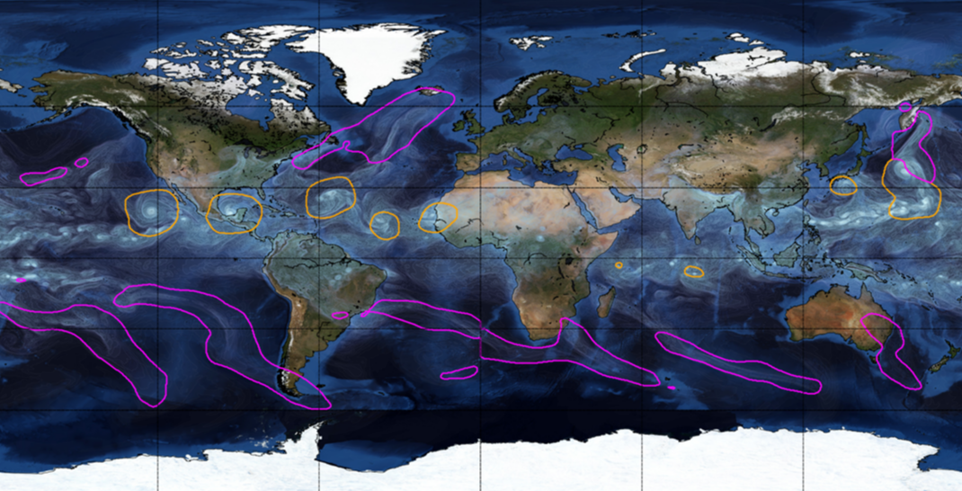
Object Detection for Remote Sensing
Instance Segmentation for Storm Detection
Source: Zhu et al. (2017), Prabhat et al. (2020)

Slide 20

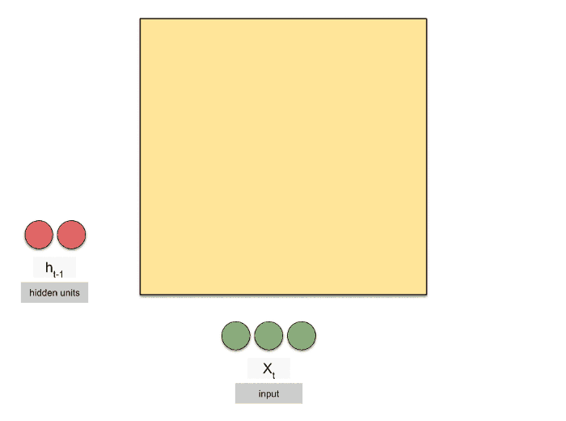
Last week: Recurrent Neural Networks (RNNs)
Regularized versions of ANNs to process temporal sequences
Source: Michael Phi, Raimi Karim (Towards Data Science)

Slide 21
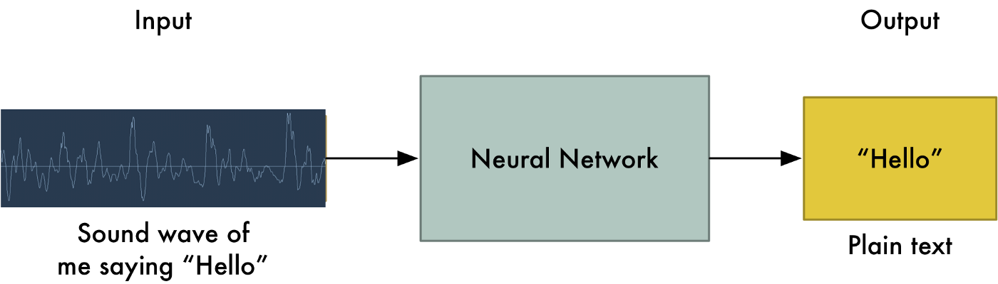

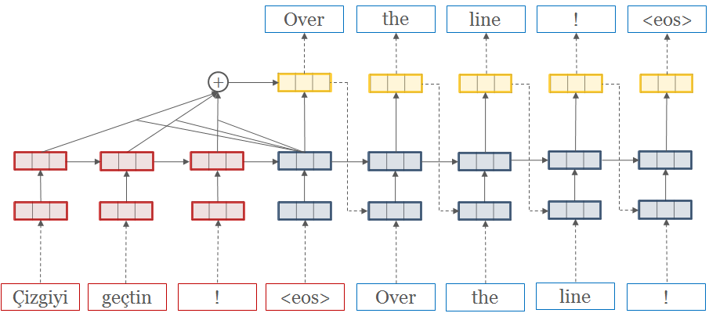
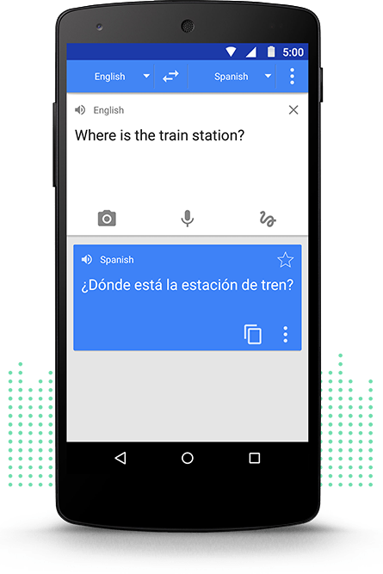
RNNs used to process temporal sequences
Speech Recognition
Machine Translation
Source: Adam Geitgey (Medium), opennmt.net, Google Translate

Slide 22
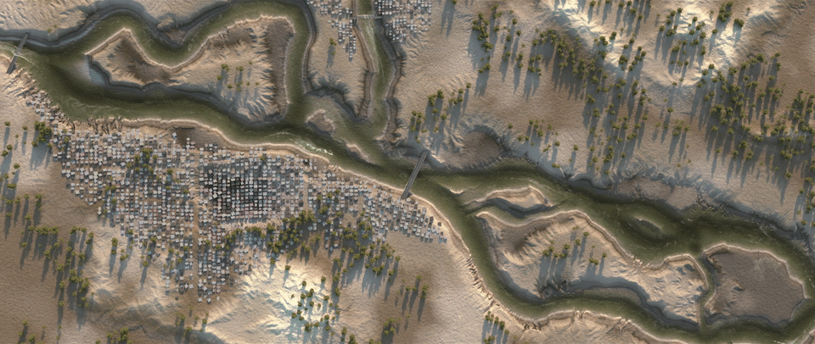
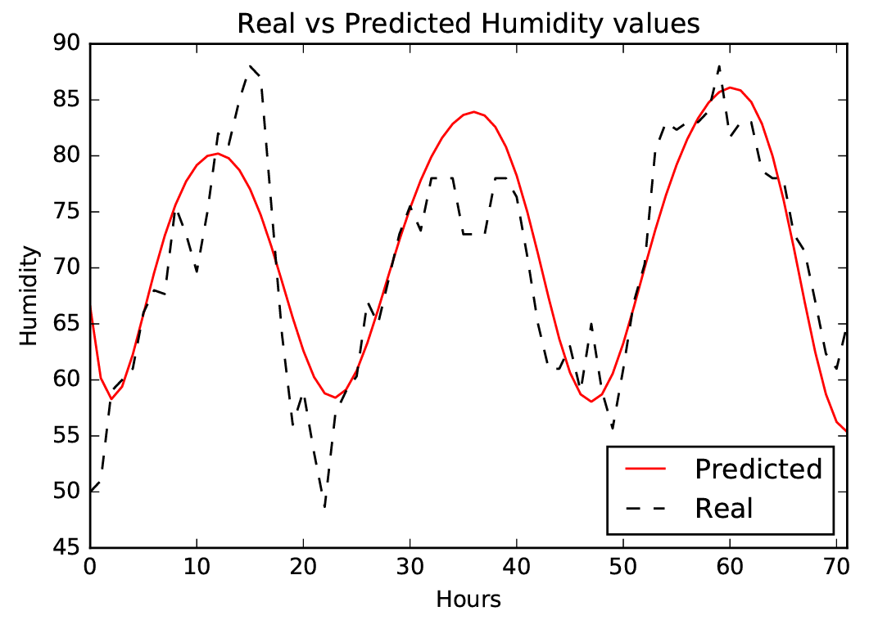
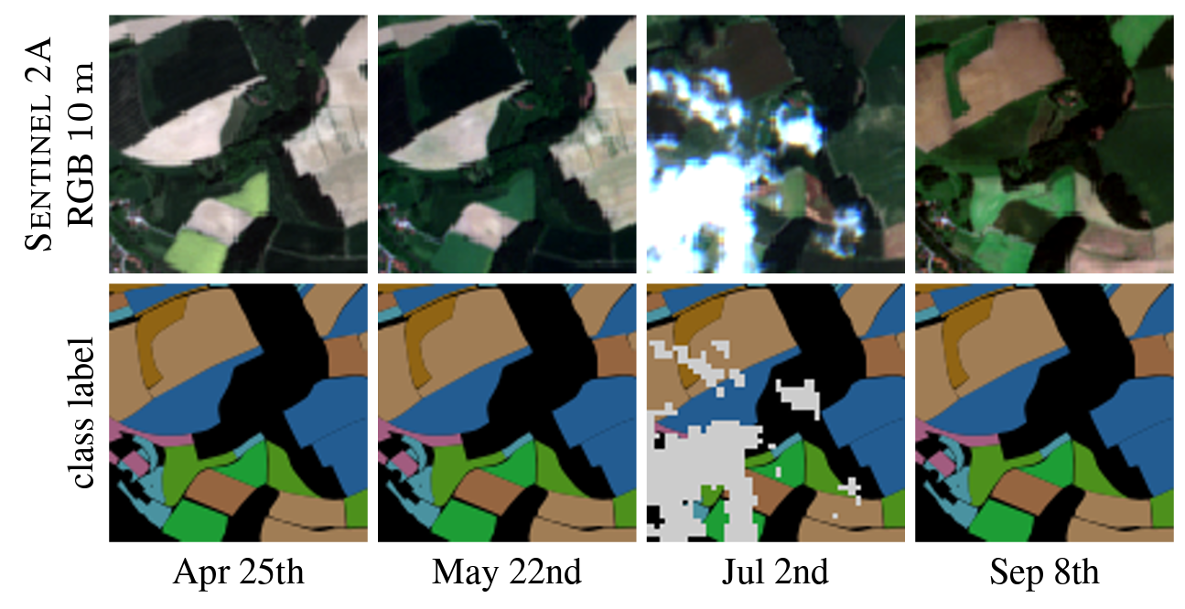
Catchment-independent rainfall-runoff models
Dynamic Time-Series Modeling
Dynamic Land Cover Classification
Source: Nadav Peleg (UNIL), Zaytar and El Amrani (2016), Russwurm et al. (2017)

Slide 23


Notes:
And at this point, it may bring back a lot of harsh memories trying to wrap your head around complex models….
Does *not* change the complexity of the model but changes the focus to explaining individual predictions

Slide 24
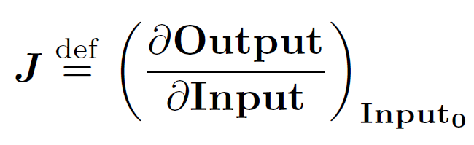
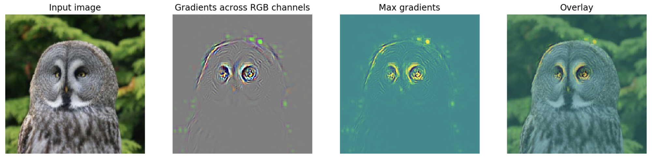
Saliency Map = Squared Jacobian of the emulated mapping
Deep learning libraries efficiently calculate Jacobian via automatic differentiation
Image source: flashtorch (Github) See: Paszke et al. (2017), Springenbert et al. (2015)
Notes:
And at this point, it may bring back a lot of harsh memories trying to wrap your head around complex models….
Does *not* change the complexity of the model but changes the focus to explaining individual predictions
VOTE: How can we make this a global explanation? Can we take the training mean of the Jacobian? Can we take the training mean of the saliency map?

Slide 25
Min 105-120: Moodle Quiz (5 questions, 15 min)
Learning Objectives (Géron Ch15 & Ch16):
Define a recurrent neural network
Distinguish recurrent from convolutional neural networks
Discuss the forecasting of environmental time series
Define natural language processing
Know at least three algorithms to process time-series

Slide 26
Legacy slides

Slide 27
Min 45-60: Moodle Quiz (5 questions, 15 min)
Learning Objectives (Molnar extracts):
Understand the importance of XAI
Distinguish local from global explanation methods
Distinguish model-agnostic from model-specific methods
Know how to implement permutation feature importance and partial dependence plots
Apprehend explanation methods for neural networks
Notes:
Questions?
Not graded

Slide 28
Min 105-120: Review Moodle Quiz
Learning Objectives (Molnar extracts):
Understand the importance of XAI
Distinguish local from global explanation methods
Distinguish model-agnostic from model-specific methods
Know how to implement permutation feature importance and partial dependence plots
Apprehend explanation methods for neural networks
Notes:
Questions?
Not graded

